Slide 1

2019-1-TR01-KA205-066443
Toplumsal Medya
Gönüllülüğüne
Gençlerin Dâhil Edilmesi
Youth Empowerment through
Community Media Volunteering

Slide 2
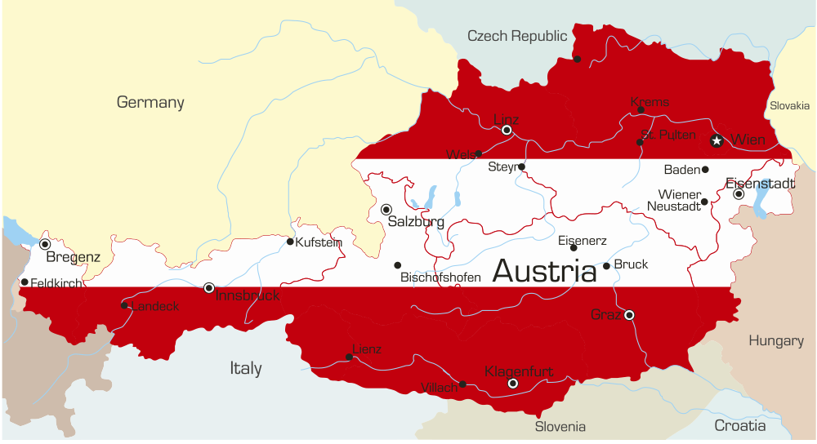
About VAEV
Non-governmental organisation located in Vienna, Austria
We aim to;
focus attention of the community on social issues of underprivileged people.
work on youth social integration issues.
promote personal development, health and employment prospects of disengaged and vulnerable people through volunteering and coaching.

Slide 3
















DigiAdults
School
Adult
Profiles
DIGIVET
Youth
VET
E-Volunteering
CM
Volunteering

Slide 4


GEM - Helping Enterprises Grow https://growingenterprises.eu/

Slide 5

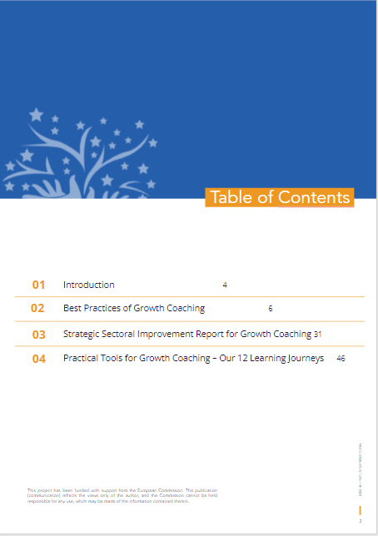
GEM Practical Handbook

Slide 6
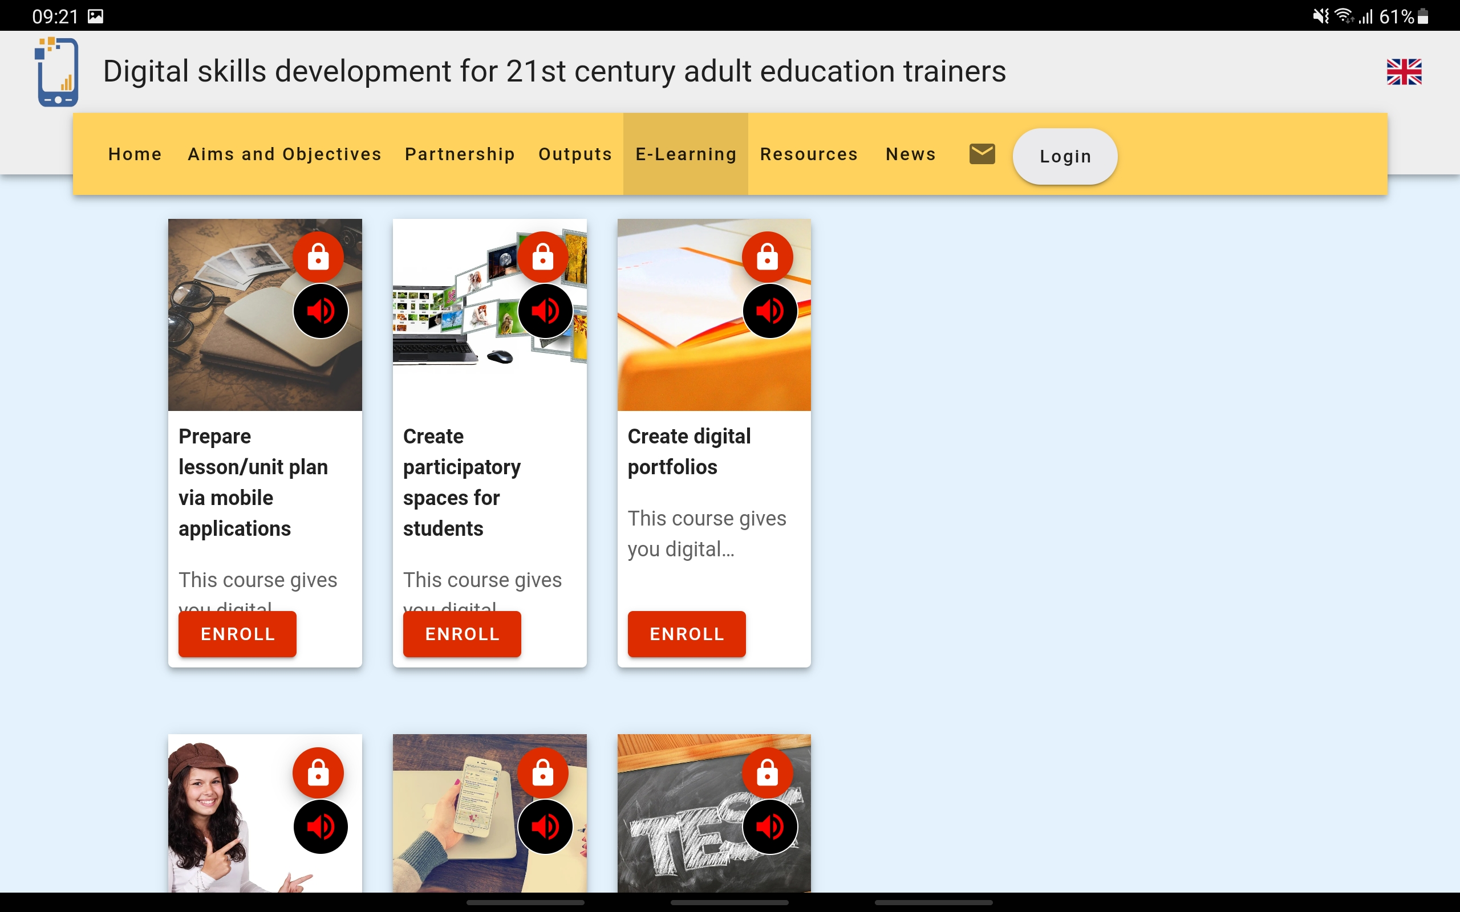

DIGISKILLS - Digital skills development for 21st century adult education trainers

Slide 7


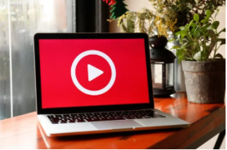
Digital platforms
E-learning platform
Mobile app
Whiteboard animation videos
Notes:
There are 3 developed platforms

Slide 8
E-learning platform
E-learning platform for community media youth volunteering developed by project partners.
E-learning platform includes:
  Free registration
  Three training units
  Quizzes
  Automatic certification
Notes:
IO3: Community media youth volunteering e-learning platform

Slide 9

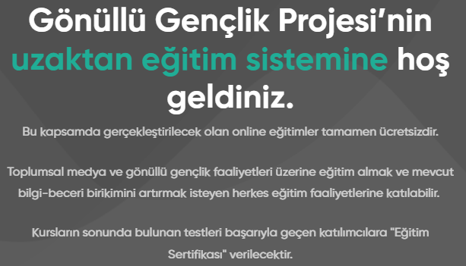
E-learning platform
https://elearning.gonullugenclik.com
Notes:
Home page, intro text

Slide 10
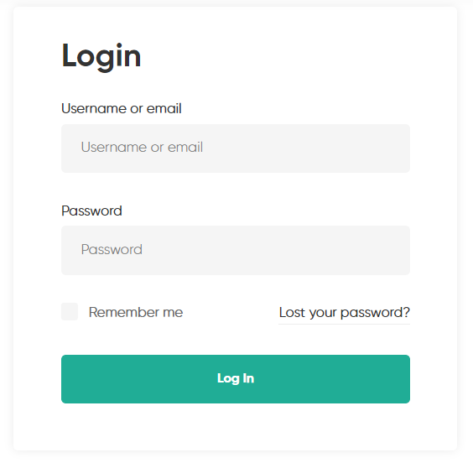
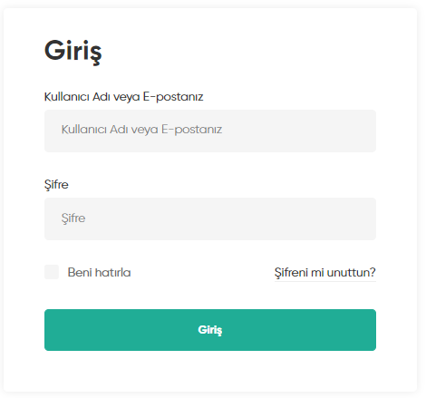
E-learning platform
https://elearning.gonullugenclik.com
Notes:
Login / Register

Slide 11
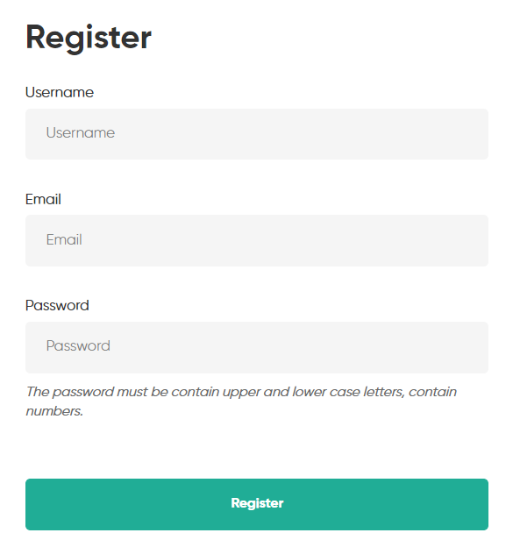
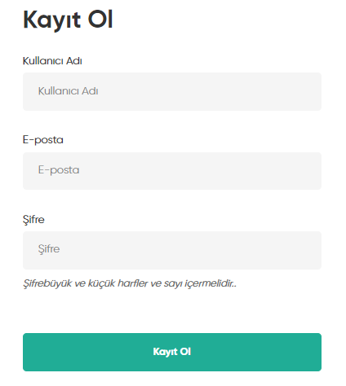
E-learning platform
https://elearning.gonullugenclik.com
Notes:
Login / Register

Slide 12
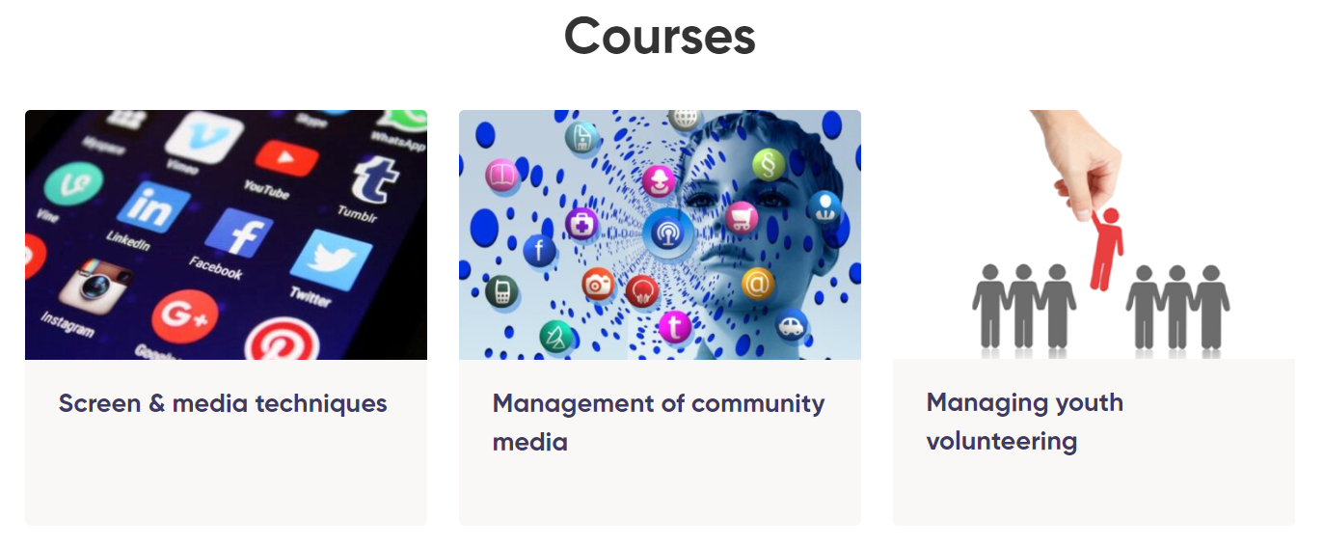
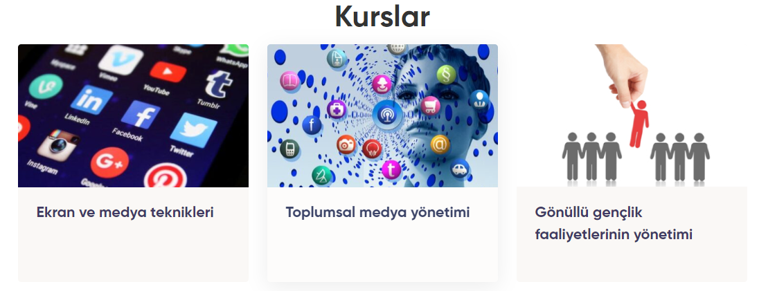
E-learning platform
https://elearning.gonullugenclik.com
Notes:
There are 3 courses developed in IO2 (Community media volunteering training toolkit)

Slide 13

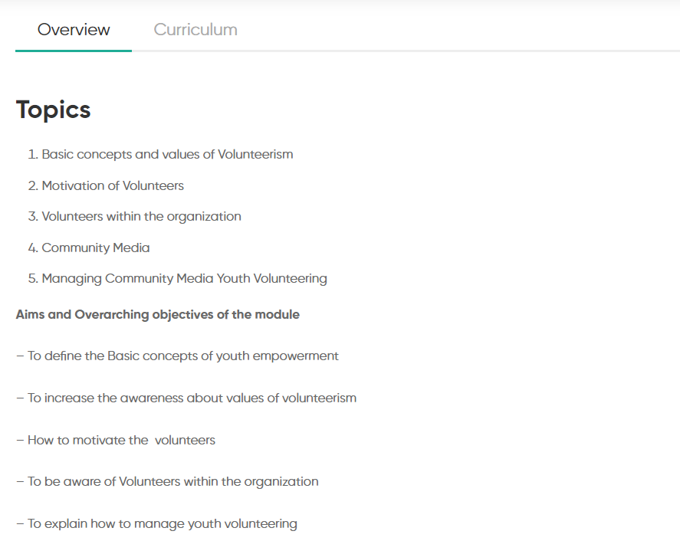
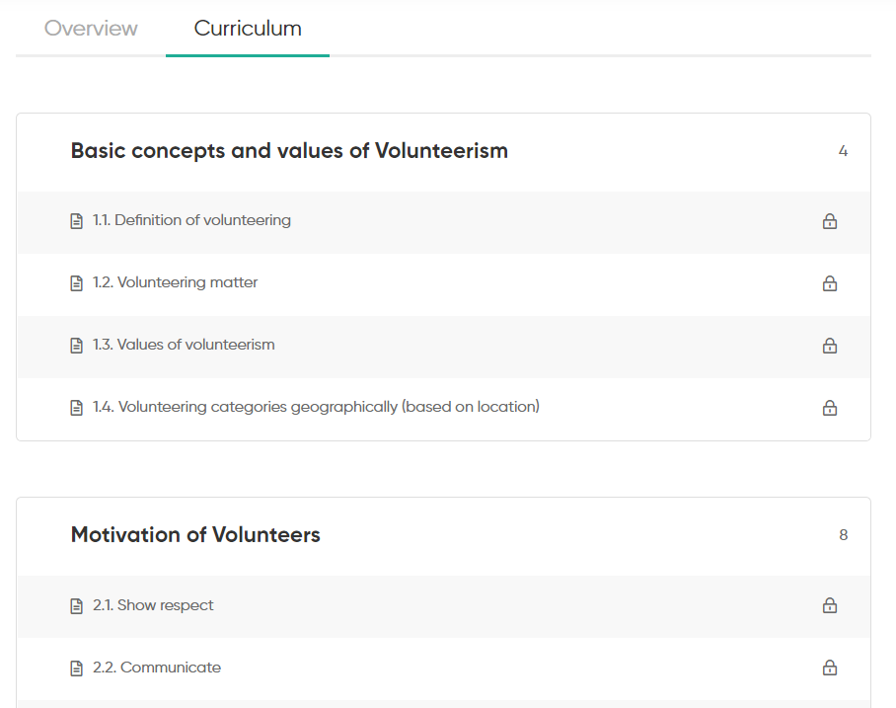
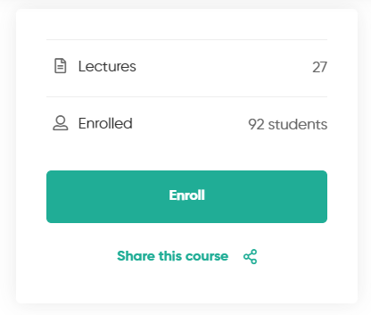
E-learning platform
Notes:
Each course includes:
Overview such as «what you will learn» section (topics, learning outcomes – konwledge,skills-competences-)
Curriculum
Number of lectures (lesson pages)
Number of enrolled users
Enroll button

Slide 14
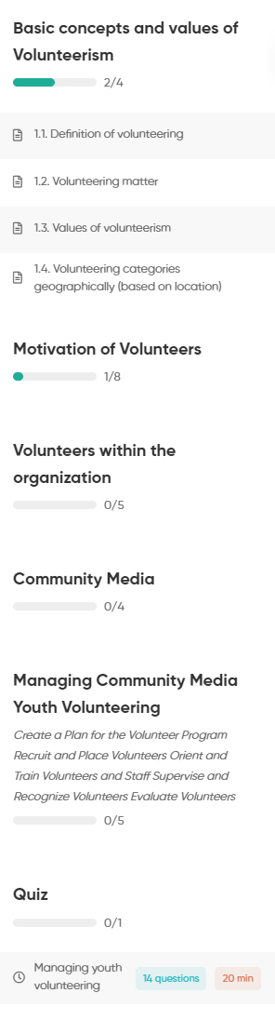
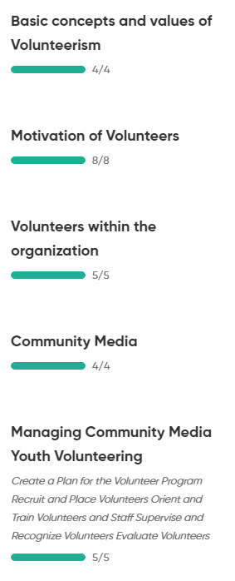
E-learning platform
1
Left menu bar
  Easy navigation
  Show each units
  and lessons
  3. See completed lesson
  such as 2/4, 1/8
  4. Quiz
3
2
4
3
Notes:
Home page, intro text

Slide 15
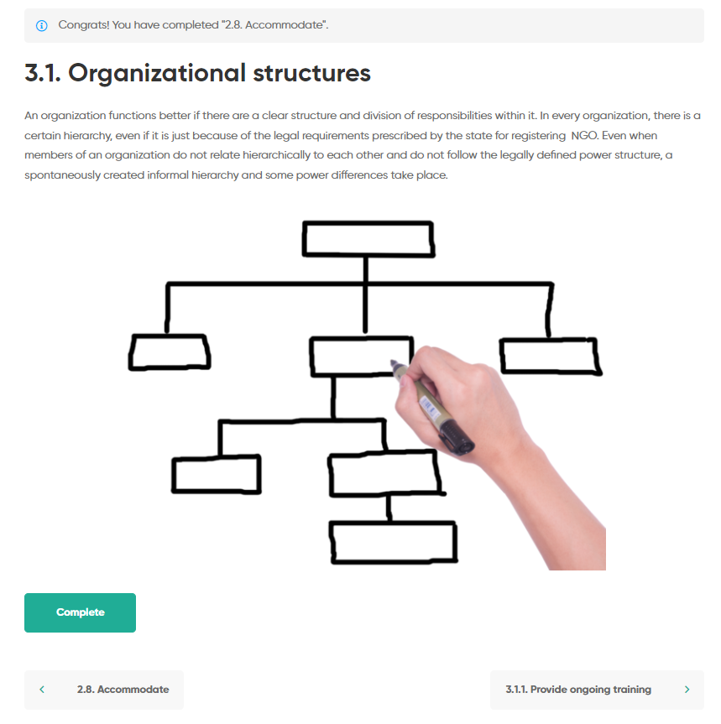
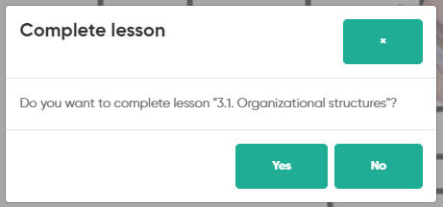
E-learning platform
1
Main screen (right side of the page)
  Message for the last completed lesson
  Training content (text & image)
  Complete the lesson button
  Previous page/lesson
  Next page/lesson
2
3
4
5

Slide 16
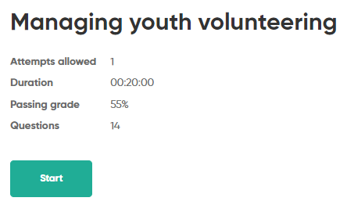
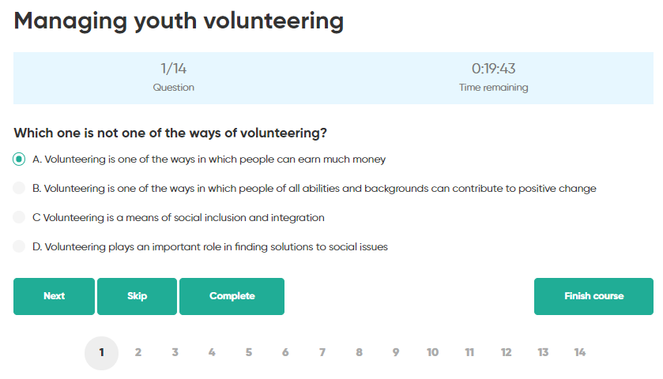
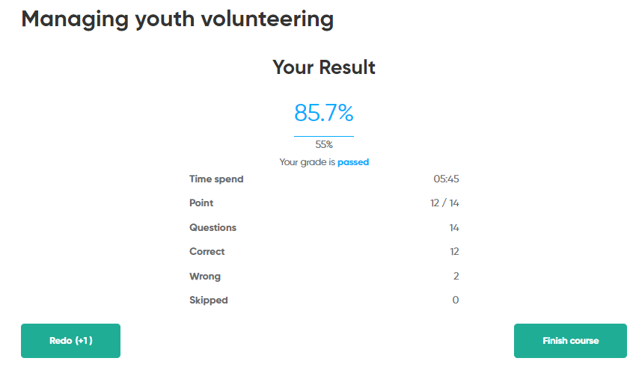
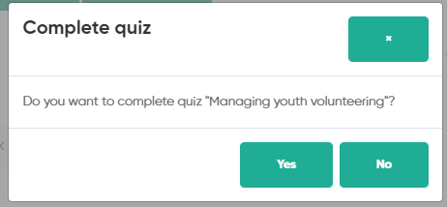
E-learning platform
2
3
1
Quiz
  Start screen
  Question
  Timer
  Buttons
  Complete button
  Result
4
6
5

Slide 17
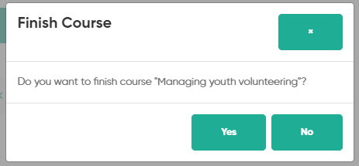
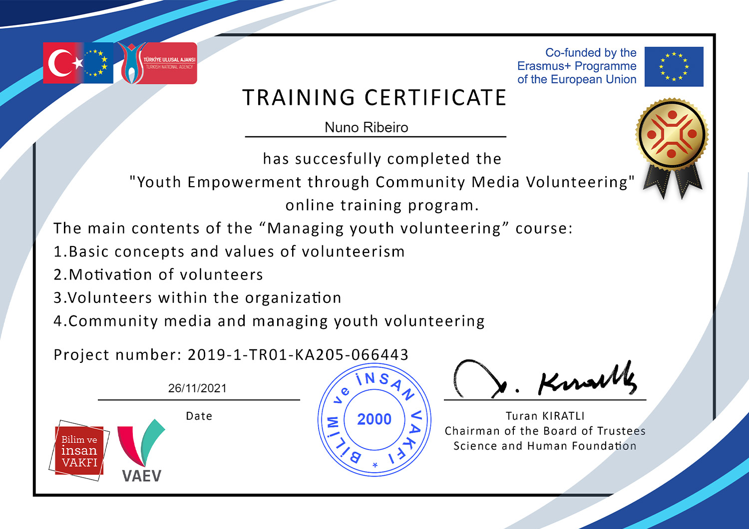
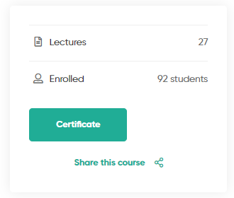
E-learning platform
Certification
  Finish the course
  Certificate
1
2

Slide 18

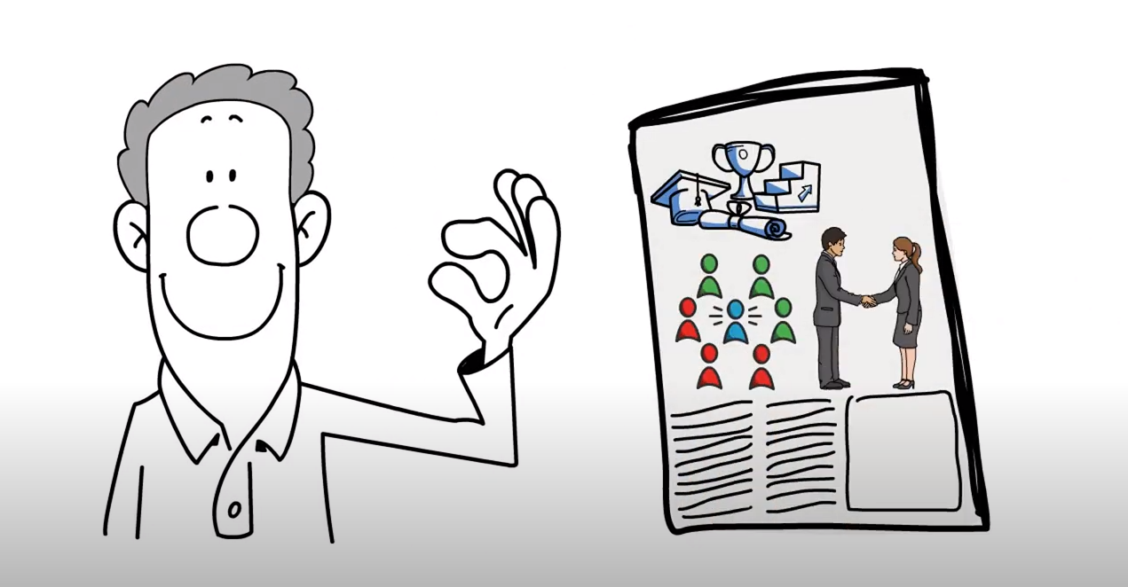
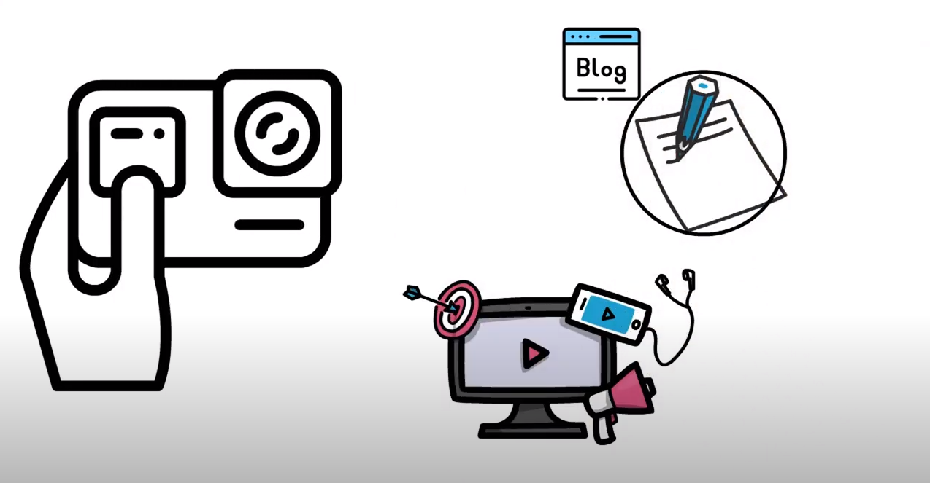
Whiteboard animation videos
Animation videos included 6 different informative videos about
  screen & media techniques
  management of community media
  managing youth volunteering
These videos will be helped to given information about community media youth volunteering to project target group.
Notes:
IO4: Community media youth volunteering animation videos

Slide 19

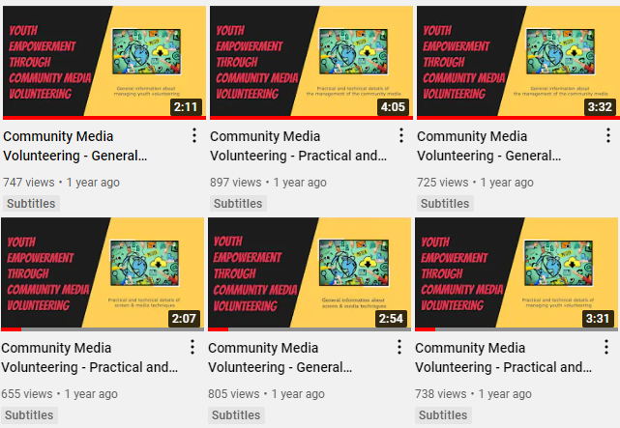
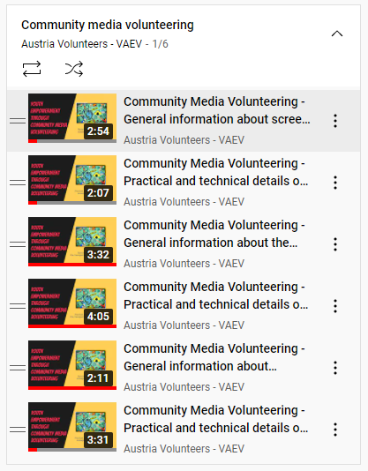
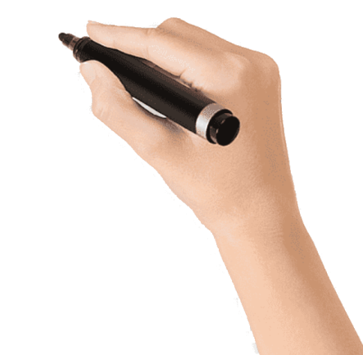
Whiteboard animation videos
4500+
views
Notes:
YouTube videos & playlist
The videos were made available to watch on YouTube and the project website

Slide 20
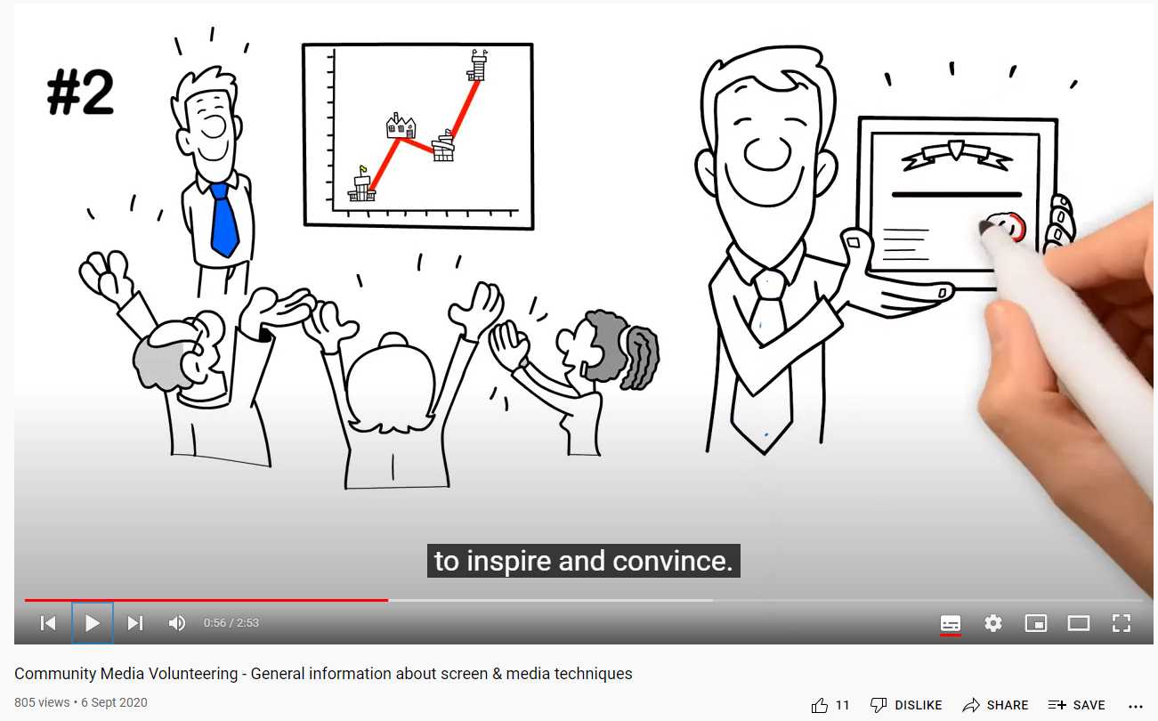
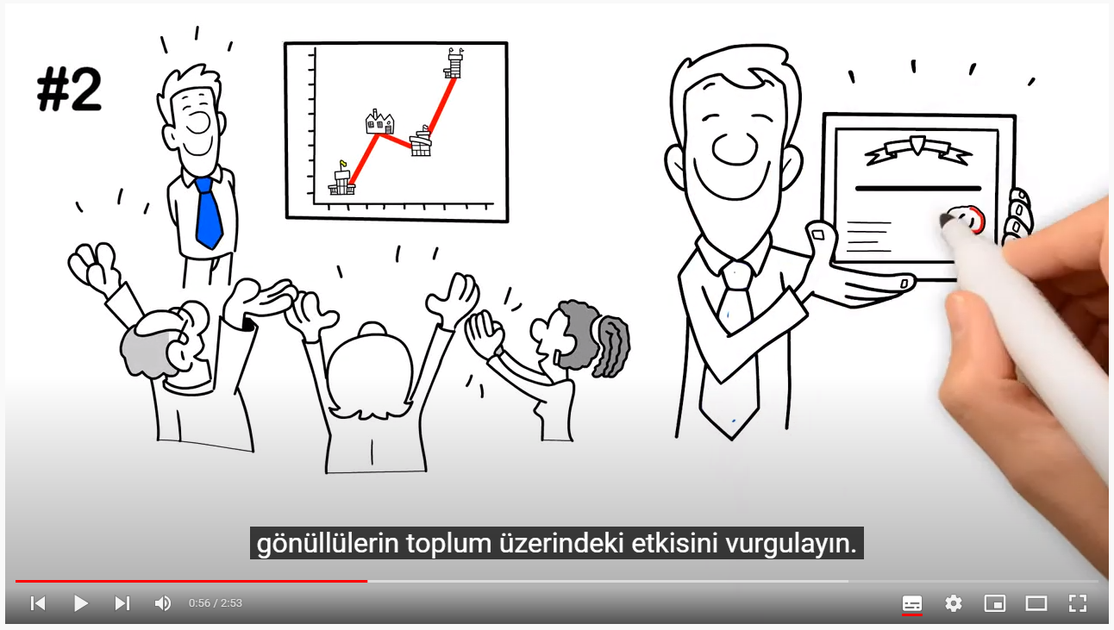
Whiteboard animation videos
Notes:
Videos include EN voice-over and TR-DE subtitles.

Slide 21
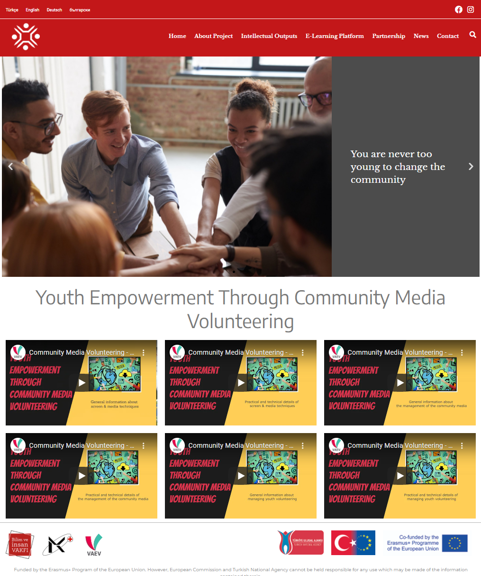
Whiteboard animation videos
Notes:
Videos at Project website (at homepage)

Slide 22
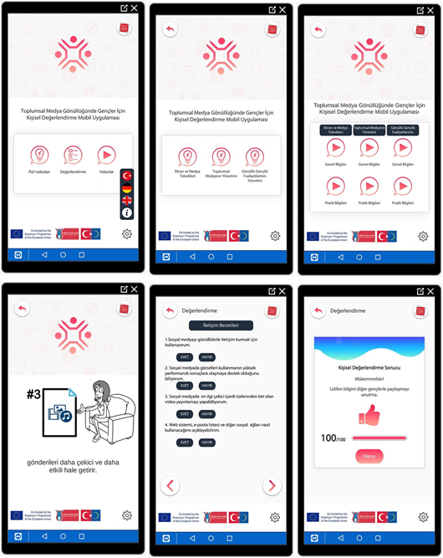
Mobile application
CM Volunteering mobile app includes:
  1. Visual practical tips about
    screen & media techniques
    management of community media
    managing youth volunteering
  2. Self assessment (checklist) of the young volunteers
  3. Animation videos
Notes:
IO5: Self assessment mobile application on community media youth volunteering

Slide 23

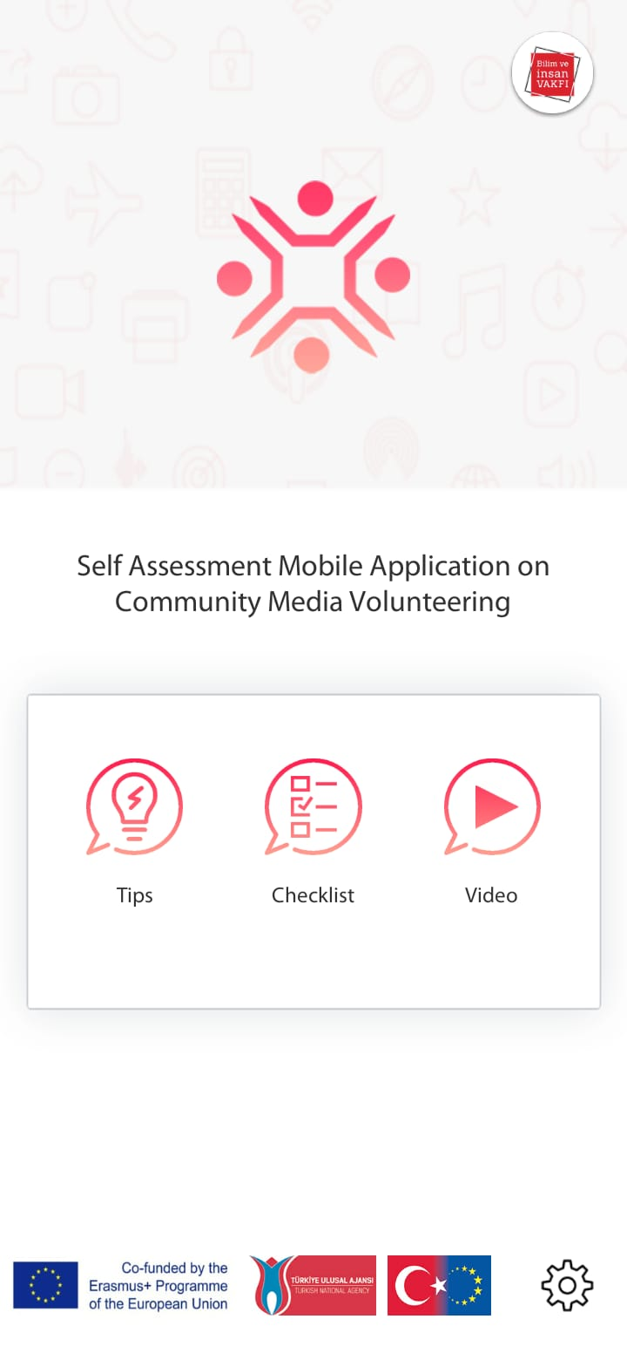
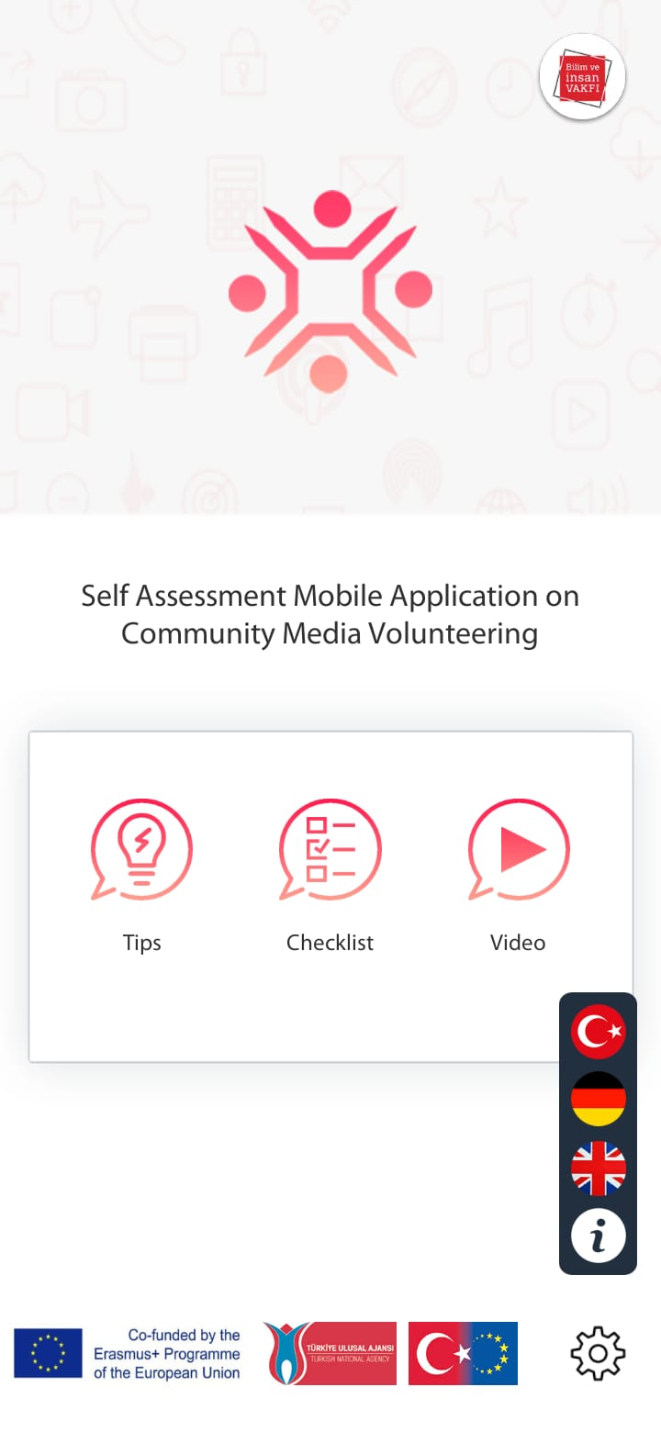

Mobile application
Loading screen Homepage Language switch Info page
Notes:
IO5: Self assessment mobile application on community media youth volunteering

Slide 24
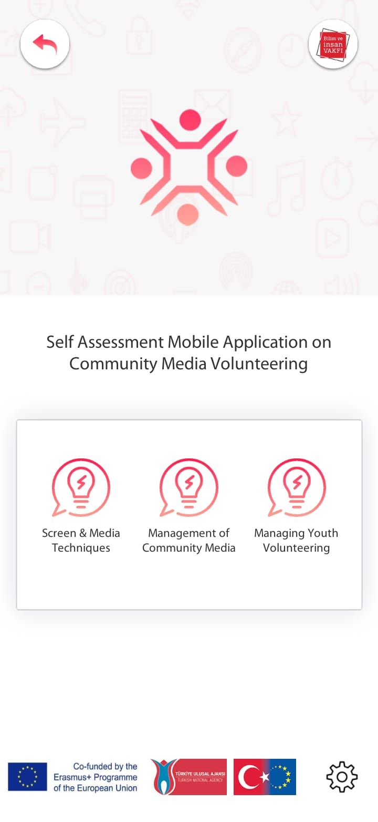
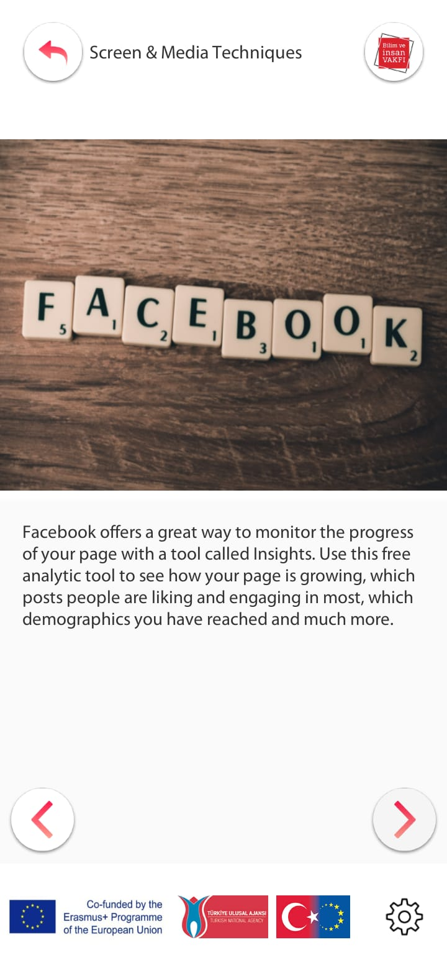
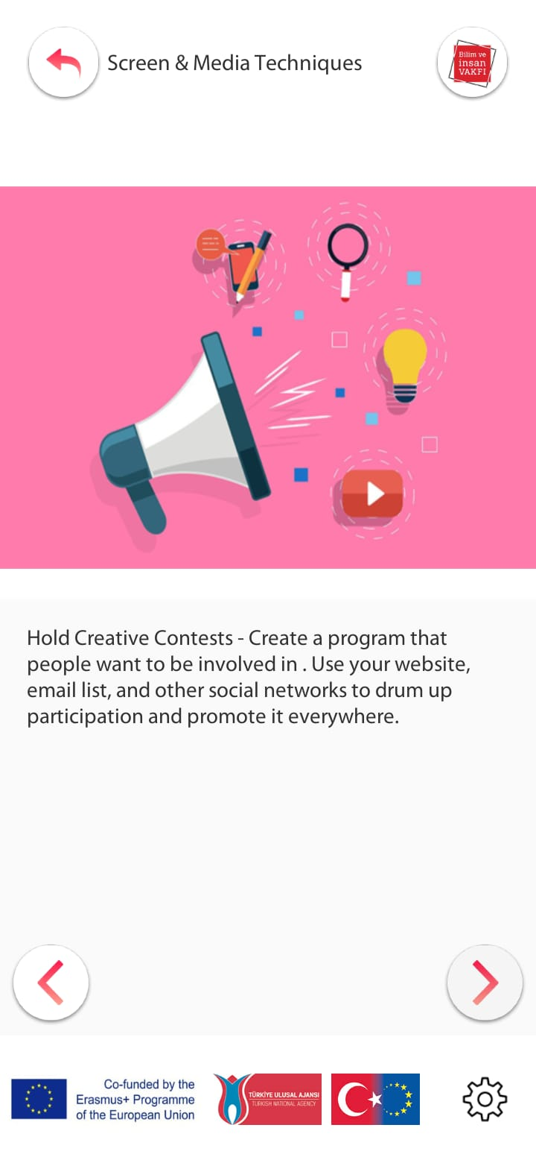
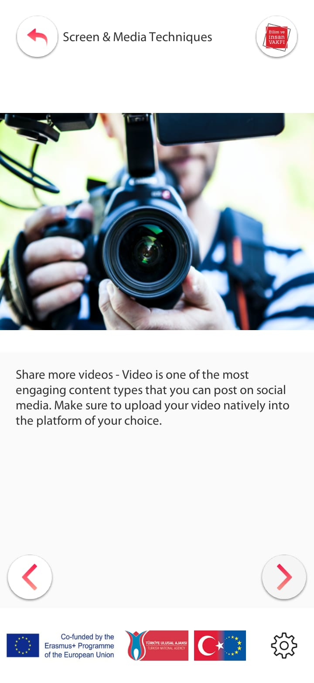
Mobile application
Visual tips page Some tips from screen & media techniques
Notes:
IO5: Self assessment mobile application on community media youth volunteering

Slide 25
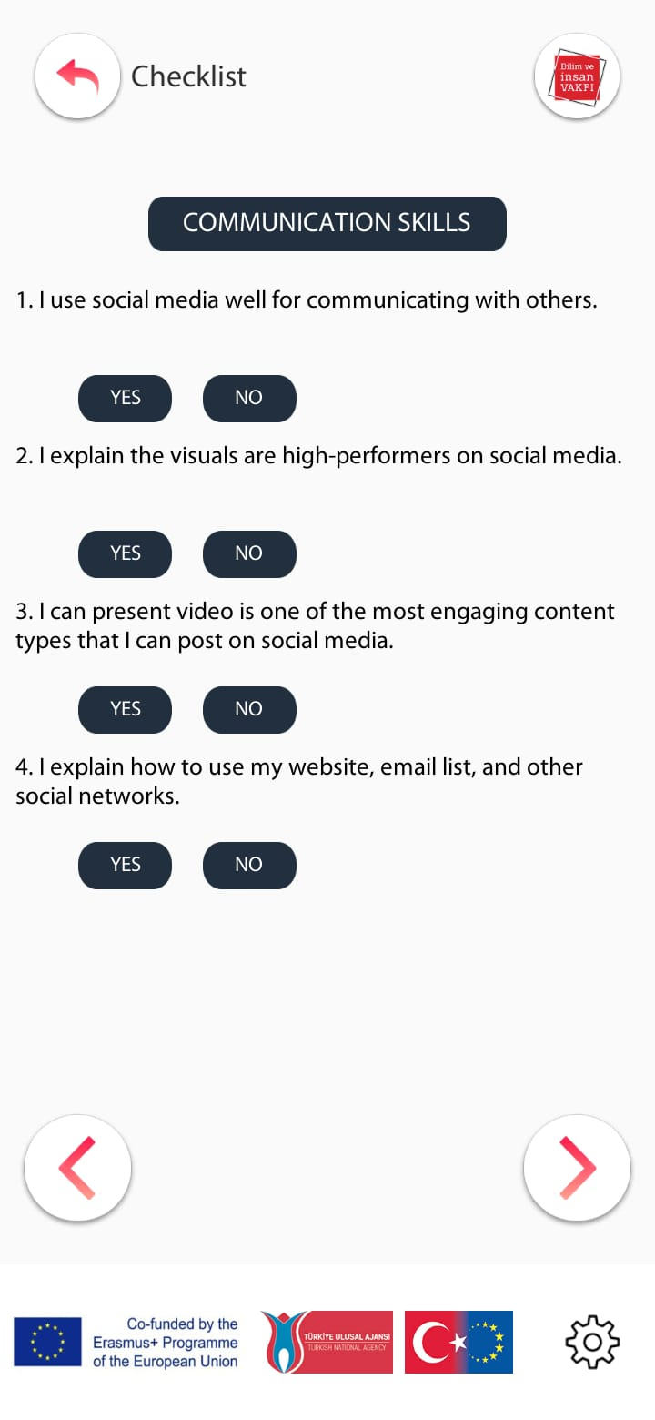

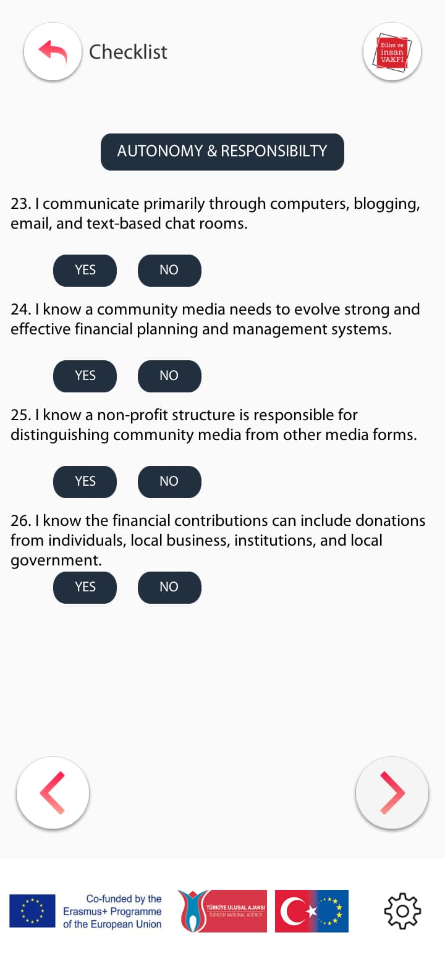
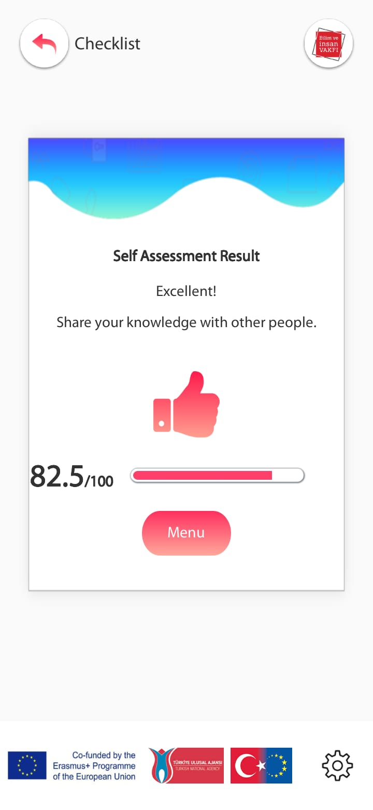
Mobile application
Self assessment (checklist) categories Result screen
Notes:
IO5: Self assessment mobile application on community media youth volunteering
There are 40 assesment. Each «YES» has 2,5 points

Slide 26
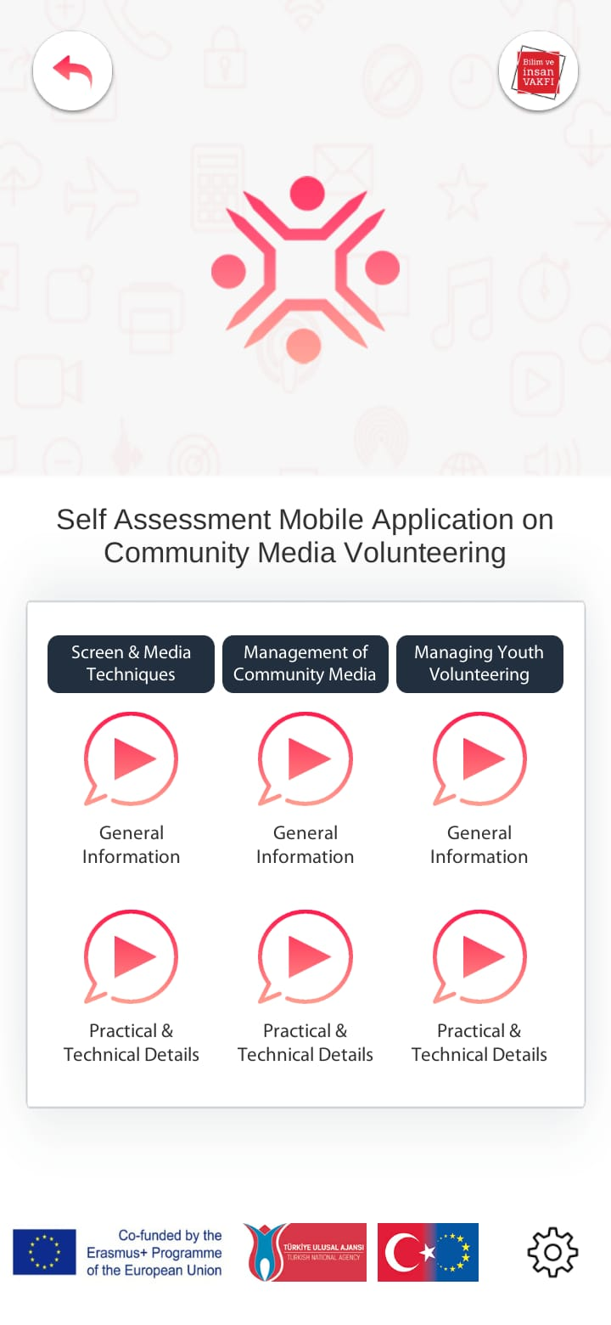
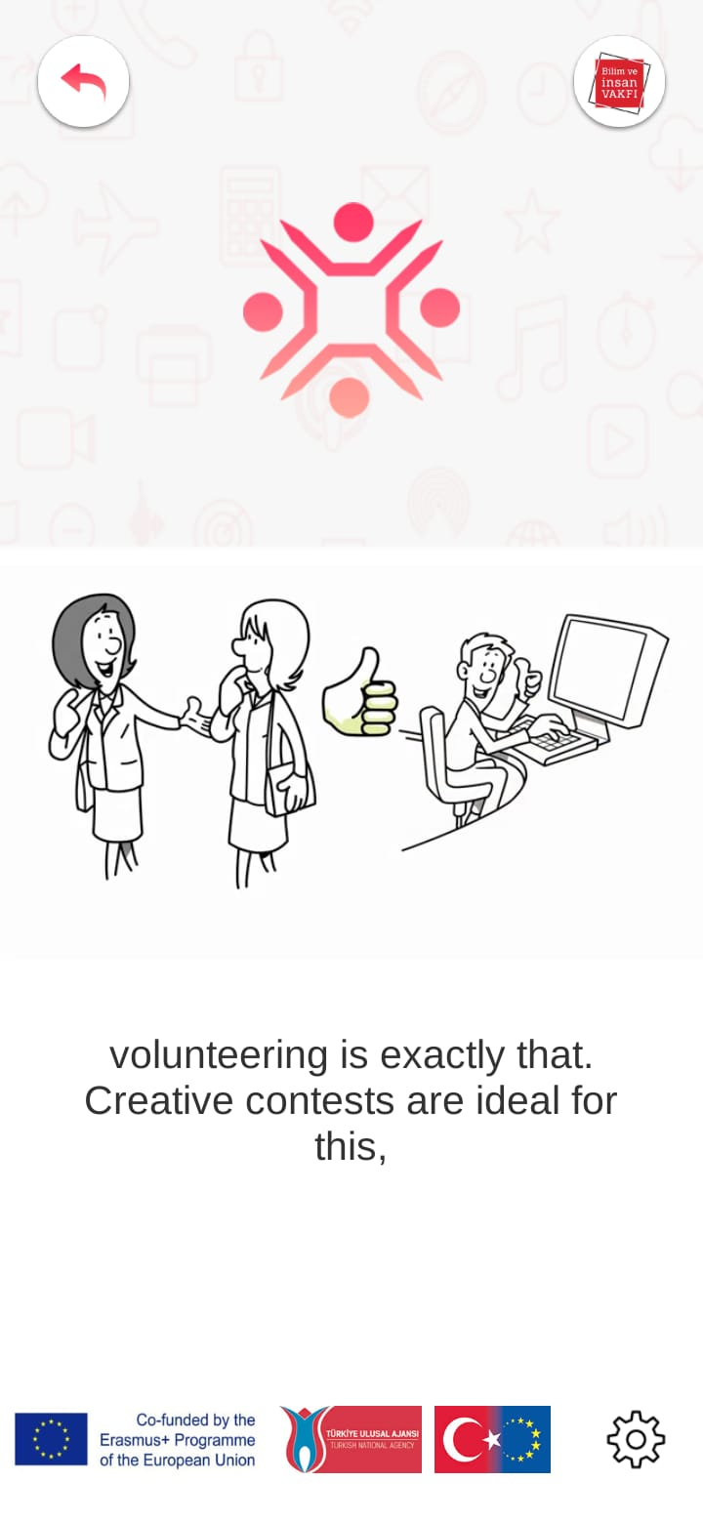

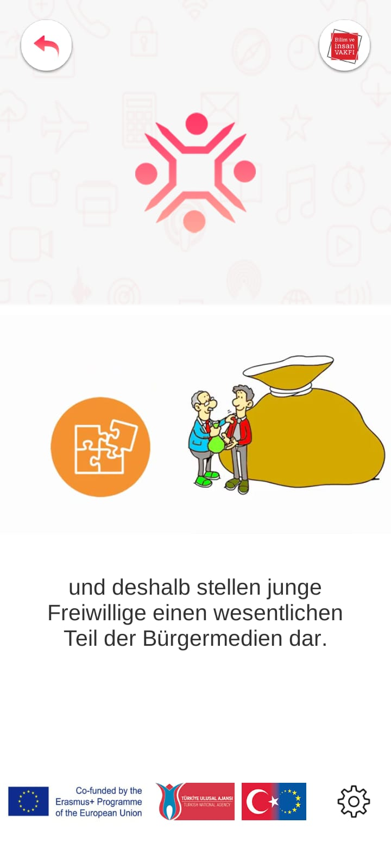
Mobile application
Videos
Notes:
IO5: Self assessment mobile application on community media youth volunteering
There are 40 assesment. Each «YES» has 2,5 points

Slide 27
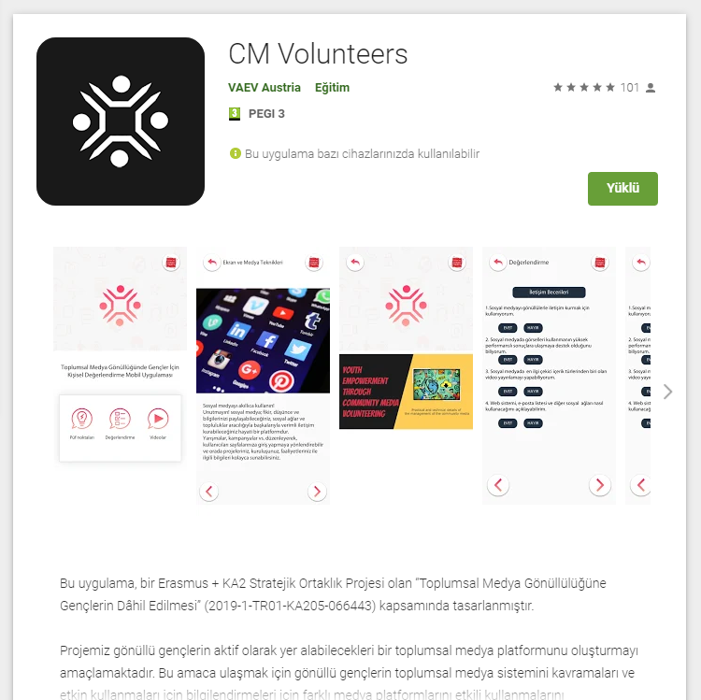
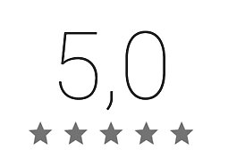
01.11.2020
Mobile application
200+
download
Actual
108 comments
Notes:
IO5: Self assessment mobile application on community media youth volunteering

Slide 28
Conclusion
Reached impact:
- Trained more than 500 young people in Austria and Turkey
- Gained knowledge competence and skills on community media volunteering
- Improved technical skills on screen & media techniques, management of community media, managing youth volunteering
- Increased attention and motivation of the young people for volunteering activities
- Engagement of young volunteers to non-formal education activities
- Greater understanding of the importance of the digital learning tools
Notes:
IO5: Self assessment mobile application on community media youth volunteering

Slide 29
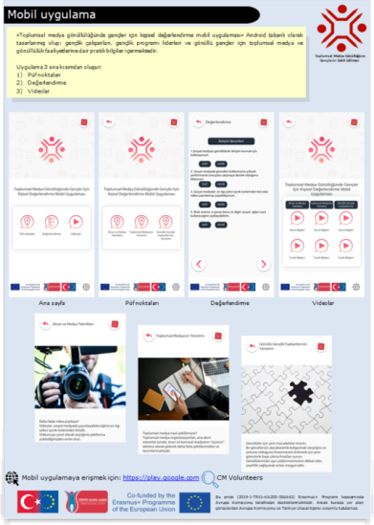
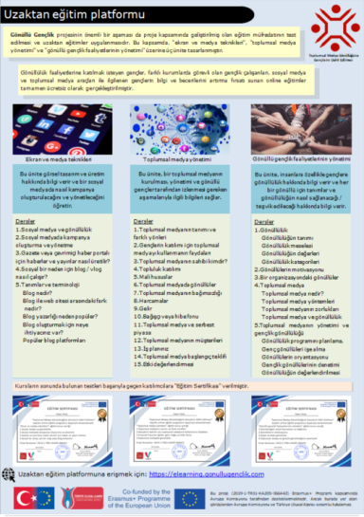


Notes:
You have printed flyers (in TURKISH) those includes details and visuals from our digital platforms in your bag (given you at registration desk).
Please visit links and contunue to use our free traninig resources.

Slide 30

Thank you for your attention
Yolanda OYUELA
Researcher
Vienna Association of Education Volunteers
www.vaev.at
info@vaev.at
Notes:
You have printed flyers (in TURKISH) those includes details and visuals from our digital platforms in your bag (given you at registration desk).
Please visit links and contunue to use our free traninig resources.

